Slide 1
INNATE (NON-SPECIFIC) IMMUNITY
Michael Frimpong, PhD
Dept. Molecular Medicine, SMS, KNUST

Slide 2
Teaching Objectives
Recognize the significance of the immune system in combating infection and disease
Distinguish between non-specific (innate) and specific (adaptive) immune systems
Understand the mechanisms combating infection/disease (killing pathogens)
Know the humoral and cellular components of the non-specific immunity
Comprehend the mechanism of action of the humoral and cellular components of non-specific immunity

Slide 3
The Immune System
Design to recognize and respond to non-self antigen in a coordinated manner
It recognizes and eliminates cells that are diseased, damaged, distressed or dying
It is divided into two (2) complementary arms: the innate and adaptive immune systems

Slide 4
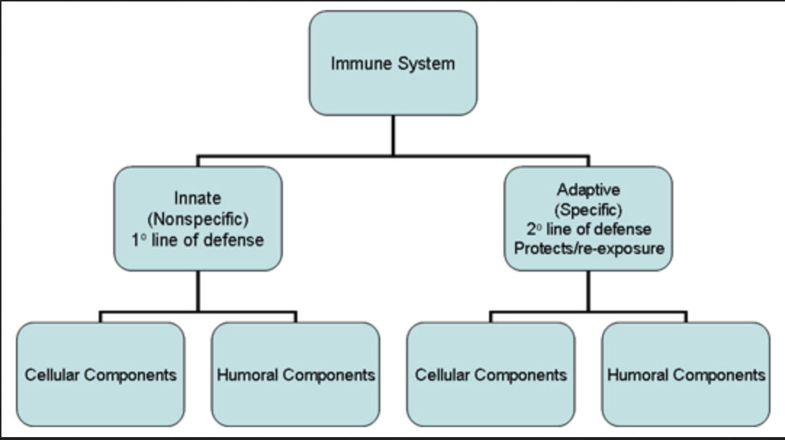
Overview of the Immune System
The innate immune system is our first line of defense against invading organisms
The adaptive immune system acts as a second line of defense and also affords protection against re-exposure to the same pathogen.
Each of the major subdivisions of the immune system has both cellular and humoral components by which they carry out their protective function
Notes:
We are constantly being exposed to infectious agents and yet, in most cases, we are able to resist these infections.
It is our immune system that enables us to resist infections. The immune system is composed of two major subdivisions, the innate or non-specific immune system and the adaptive or specific immune system (Figure 1).
Although these two arms of the immune system have distinct functions, there is interplay between these systems (i.e., components of the innate immune system influence the adaptive immune system and vice versa).

Slide 5
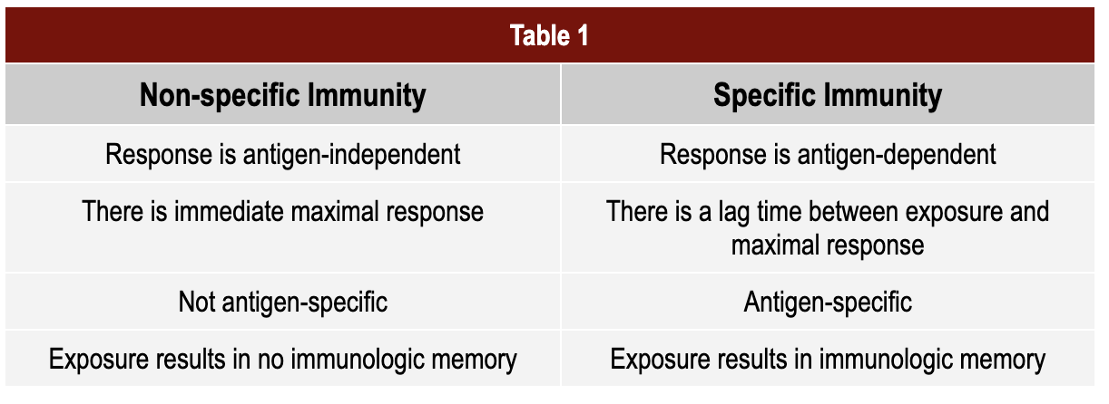
Overview of the Immune System

Slide 6
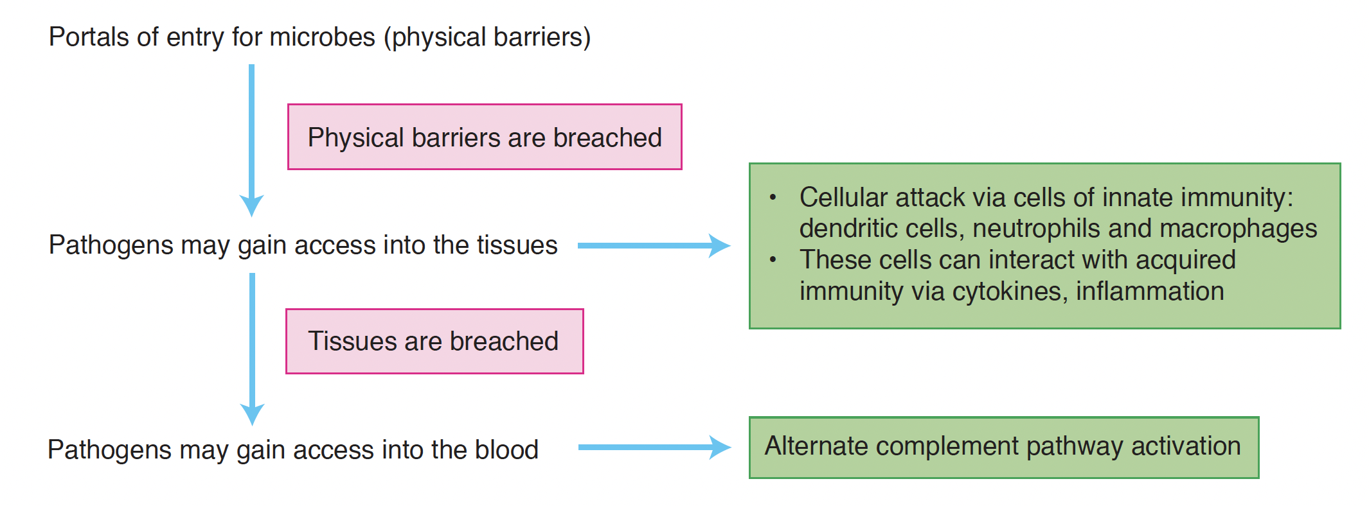
Innate Immunity
Notes:
- Innate immunity is responsible for reacting quickly to invading microbes and for keeping the host alive while the adaptive immune system is developing a very specific response
The innate immune defenses are present at birth; they have limited diversity for antigen, and they attack microbes with the same basic vigor no matter how many times they seen the same pathogen
Microbes may gain access to the tissue if the physical barriers are breached. In the tissues, they come into contact with phagocytic cells such as neutrophils, macrophages and dendritic cells, which produce chemical messengers called cytokines that can initiate an inflammatory response.
Many times this is enough to eliminate the pathogen, but not always. The pathogen may get access to the blood, in which the alternative pathway of complement activation may provide some additional help.
But this is where the adaptive immunity may have to take over and resolve the infection and eliminate the pathogen.

Slide 7
Anatomical barriers to infections
Mechanical factors
The skin and epithelial surfaces form a physical barrier that is very impermeable to most infectious agents.
Movement due to cilia or peristalsis helps to keep air passages and the gastrointestinal tract free from microorganisms.
The flushing action of tears and saliva helps prevent infection of the eyes and mouth.
The trapping effect of mucus that lines the respiratory and gastrointestinal tract helps protect the lungs and digestive systems from infection.

Slide 8
Anatomical barriers to infections
Chemical factors
Fatty acids in sweat inhibit the growth of bacteria.
Lysozyme and phospholipase found in tears, saliva and nasal secretions can breakdown the cell wall of bacteria and destabilize bacterial membranes.
The low pH of sweat and gastric secretions prevents growth of bacteria.
Defensins (low molecular weight proteins) found in the lung and gastrointestinal tract have antimicrobial activity.
Surfactants in the lung act as opsonins.
Biological factors
The normal flora of the skin and in the gastrointestinal tract can prevent the colonization of pathogenic bacteria.

Slide 9
Humoral barriers to infection
Once infectious agents have penetrated tissues, another innate defense mechanism comes into play, namely acute inflammation.
Humoral factors play an important role in inflammation, which is characterized by edema and the recruitment of phagocytic cells.
These humoral factors are found in serum or they are formed at the site of infection.
Notes:
The anatomical barriers are very effective in preventing colonization of tissues by microorganisms. However, when there is damage to tissues the anatomical barriers are breached and infection may occur.

Slide 10
Humoral barriers to infection
Complement system
The complement system is the major humoral non-specific defense mechanism.
complement activation can lead to increased vascular permeability, recruitment of phagocytic cells, and lysis and opsonization of bacteria.
Coagulation system
The coagulation system may be activated depending on severity of tissue damage.
products of the coagulation system can contribute to the non-specific defenses by increasing vascular permeability or act as chemotactic agents for phagocytic cells or directly as antimicrobial.
Ex. beta-lysin, a protein produced by platelets during coagulation can lyse many Gram-positive bacteria by acting as a cationic detergent.

Slide 11
Humoral barriers to infection
Lactoferrin and transferrin
By binding iron, an essential nutrient for bacteria, these proteins limit bacterial growth.
Interferons
Interferons are proteins that can limit virus replication in cells.
Lysozyme
Lysozyme breaks down the cell wall of bacteria.
Interleukin-1
Il-1 induces fever and the production of acute phase proteins, some of which are antimicrobial because they can opsonize bacteria.

Slide 12
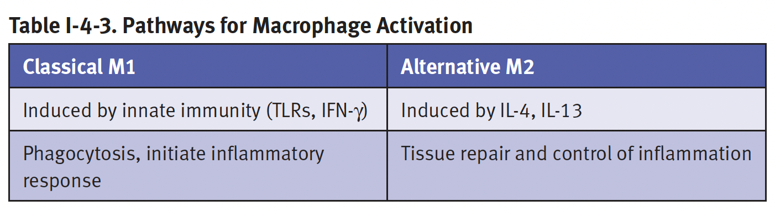
Cellular Components of the Innate Immunity
Neutrophils
Polymorphonuclear cells (PMNs) are recruited to the site of infection where they phagocytose invading organisms and kill them intracellularly.
PMNs contribute to collateral tissue damage that occurs during inflammation.
Macrophages
Tissue macrophages and newly recruited monocytes differentiate into macrophages, function in phagocytosis and intracellular killing of microorganisms.
macrophages are capable of extracellular killing of infected or altered self target cells.
macrophages contribute to tissue repair and act as antigen-presenting cells

Slide 13
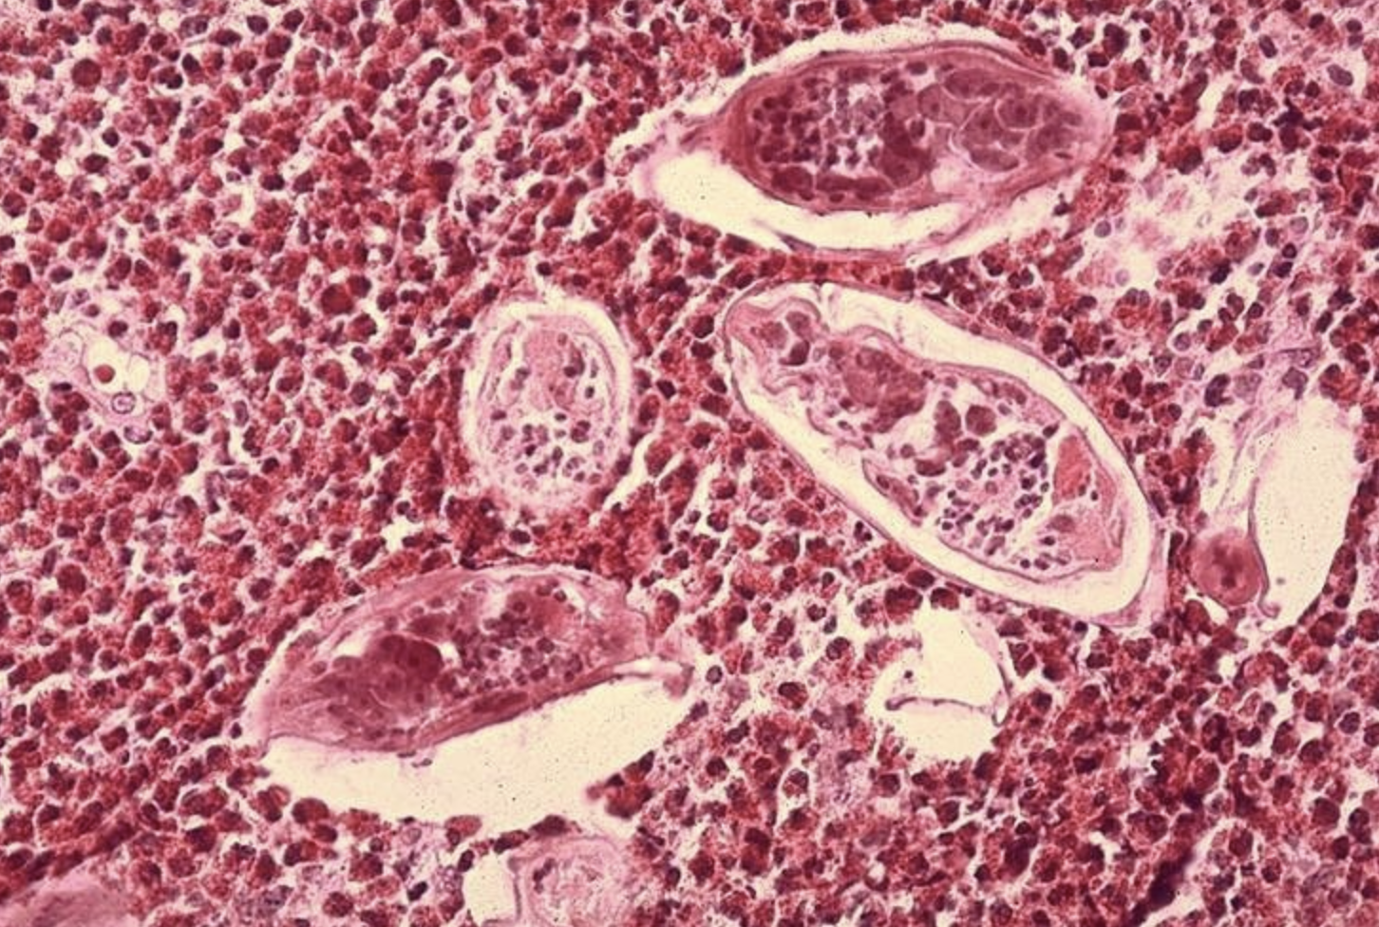
Cellular Components of the Innate Immunity
Natural killer (NK) and lymphokine activated killer (LAK) cells
NK and LAK cells can nonspecifically kill virus infected and tumor cells.
These cells are not part of the inflammatory response but they are important in nonspecific immunity to viral infections and tumor surveillance.
Eosinophils
Eosinophils have proteins in granules that are effective in killing certain parasites.

Slide 14
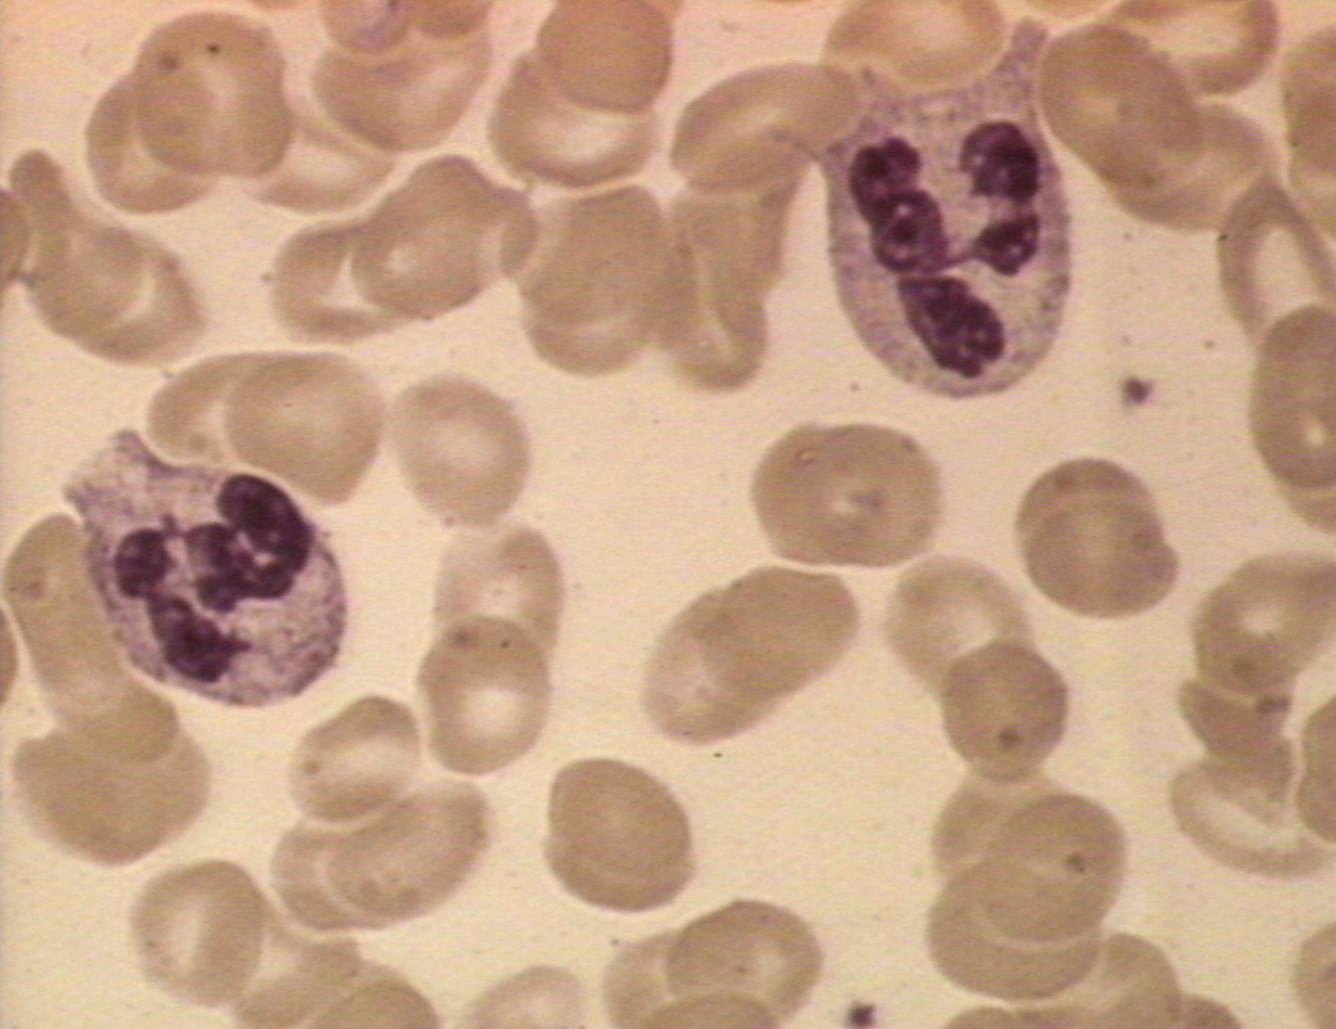
Phagocytosis and Intracellular Killing
Phagocytic cells
Neutrophiles/Polymorphonuclear cells
PMNs are motile phagocytic cells that have lobed nuclei.
They can be identified by their characteristic nucleus or by cell surface antigen called CD66.
Their granules contain
cationic proteins and defensins that can kill bacteria,
proteolytic enzymes like elastase, and cathepsin G to breakdown proteins,
lysozyme to break down bacterial cell walls
myeloperoxidase, which is involved in the generation of bacteriocidal compounds.

Slide 15
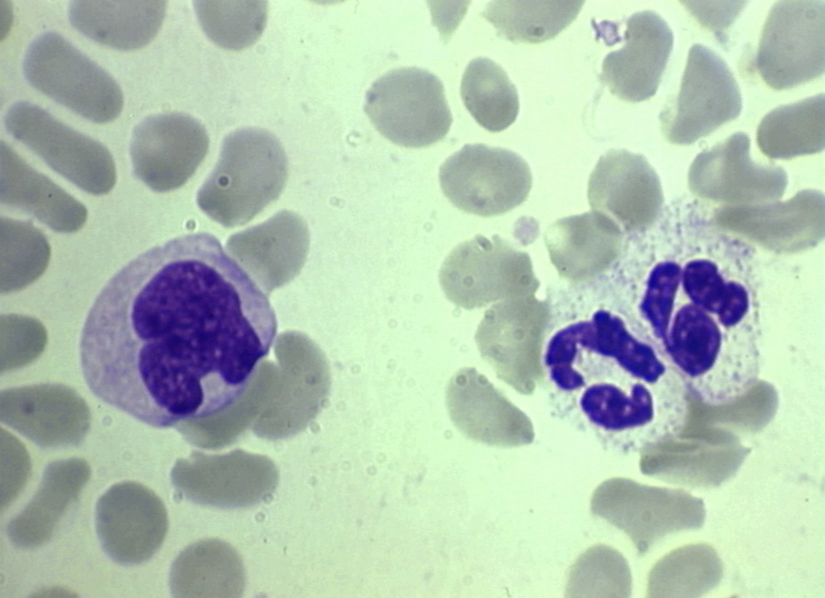
Phagocytic cells
Monocytes/Macrophages
Have a characteristic kidney-shaped nucleus.
They can be identified morphologically or by the presence of the CD14 cell surface marker.
Do not contain granules but they have numerous lysosomes which have contents similar to the PNM granules.

Slide 16
Inflammatory Response
The first response to invasion and represents a response to the innate immune system to block a challenge.
It starts with the activation of the vascular endothelium in the breached epithelial barrier.
Cytokines and inflammatory mediators released as a result of tissue damage induce the expression of selectin-type adhesion molecules on the epithelial cells.
This allows neutrophils to bind inflamed epithelium and extravasate into the tissue, followed by monocytes, and macrophages in response to neutrophil-released mediators

Slide 17
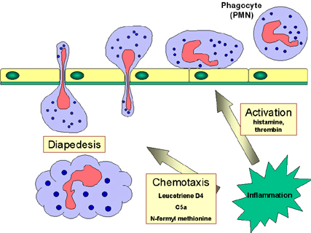
Response of phagocytes to infection
Circulating PMNs and monocytes respond to danger (SOS) signals generated at the site of an infection.
SOS signals include;
N-formyl-methionine containing peptides released by bacteria
clotting system peptides, complement products and cytokines released from tissue macrophages that have encountered bacteria in tissue.
SOS signals stimulate endothelial cells near the site
of the infection to express cell adhesion molecules
such as ICAM-1 and selectins.
Vasodilators enable phagocytes to cross endothelial
barrier.

Slide 18
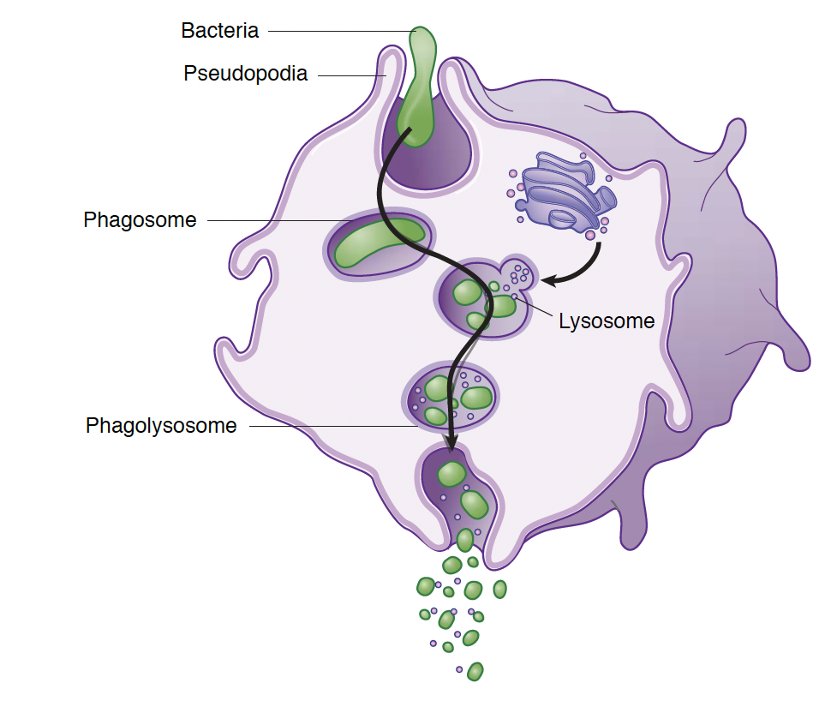
Phagocytosis
Once chemotaxis of phagocytic cells into the area of antigen is accomplished.
Cells ingest and digest particulate debris, pathogens etc.
Phagocytosis involves these stages;
Extension of pseudopodia to engulf material
Fusion of pseudopodia to trap material in phagosome
Fusion of phagosome with lysosome to form a phagolysosome
Digestion
Exocytosis of digested content

Slide 19
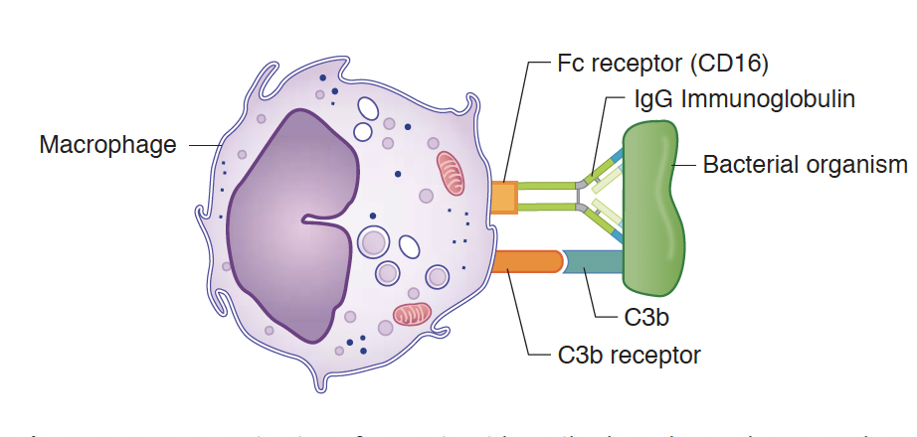
Opsonization
Macrophages and neutrophils have membrane receptors for antibody and complement components.
Antigens coated by antibody or complement components enhance phagocytosis by 4K fold
The process of enhance phagocytosis by opsonins is called opsonization.

Slide 20
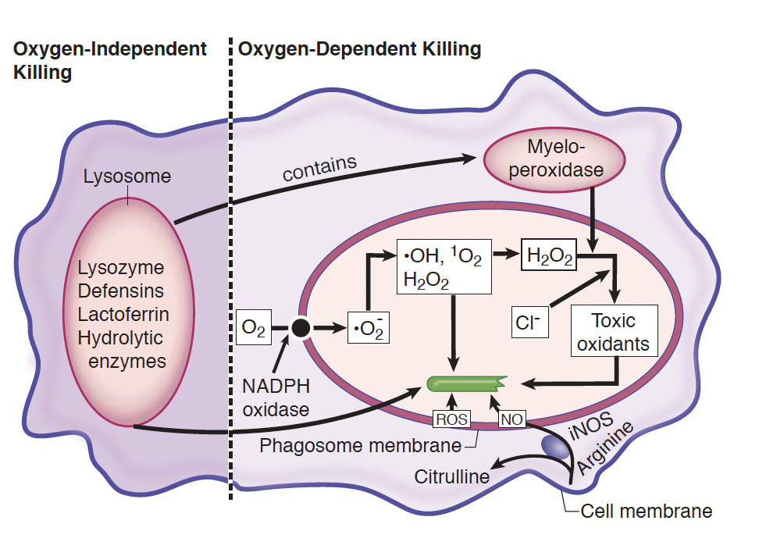
Intracellular Killing
During phagocytosis, a metabolic process known as respiratory burst activate membrane-bound oxidase that generate oxygen metabolites
Two oxygen-dependent mechanisms of intracellular digestion
Lysosomal contents of oxygen-independent degradative material
Notes:
- NADPH oxidase reduces O₂ to superoxide anion, which generates hydroxyl radicals and hydrogen peroxide, which are microbicidal.
Myeloperoxidase from lysosome acts on hydrogen peroxide and chloride ions to produce hypochlorite (active ingredient in bleach), which is microbicidal.
Lysozyme digest bacterial cell by cleaving peptidoglycans
Defensins form channels in bacterial cell wall
Lactoferrin chelate iron

Slide 21
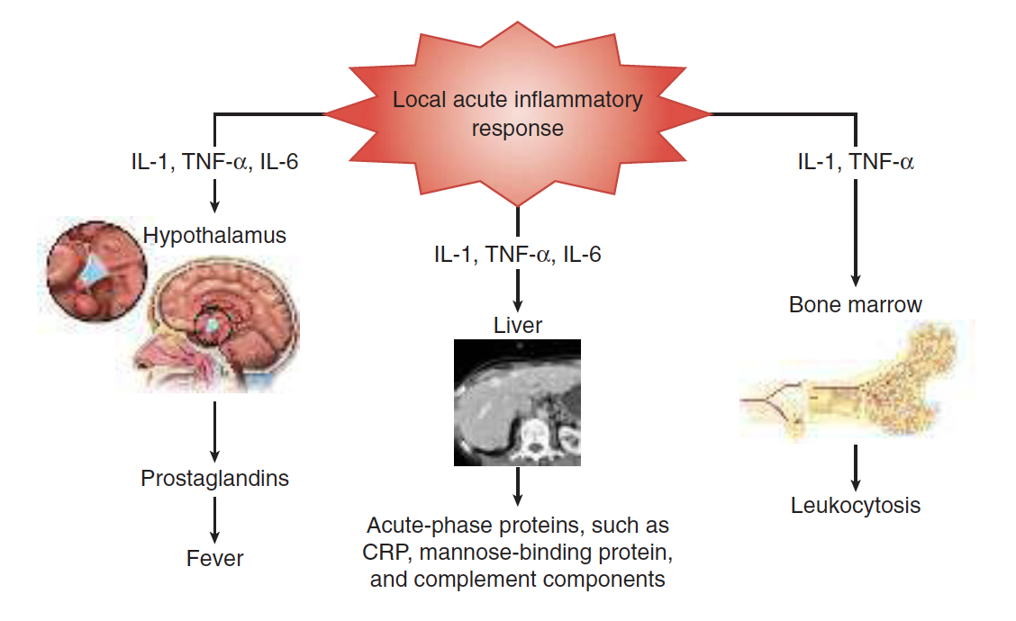
Systemic Inflammation
Notes:
- During acute inflammatory response, pro-inflammatory cytokines, IL-1, TNF-a and IL-6 are produced.
- These cytokines has systemic effect on tissues including fever, production of acute phase proteins and leukocytosis.

Slide 22
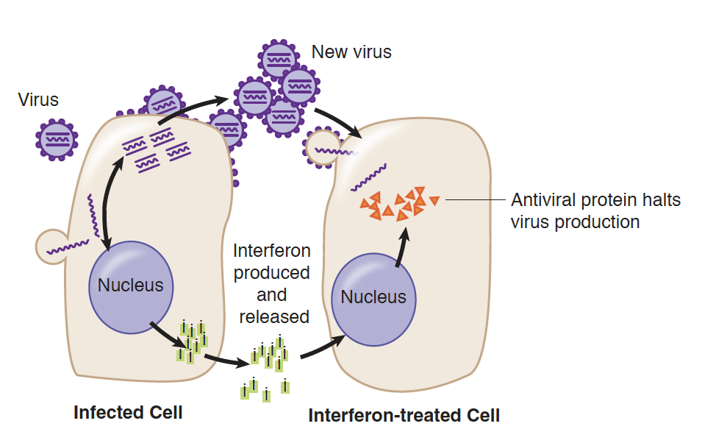
Innate Response to Viruses
Two major mechanisms for dealing with viral infections
IFN-⍺/𝛃 and NK cells
Interferons
IFN- ⍺ and IFN-𝛃 are produced by viral-infected cells
Act on target cell to inhibit viral replication, not the virus
They also inhibit viral protein synthesis

Slide 23
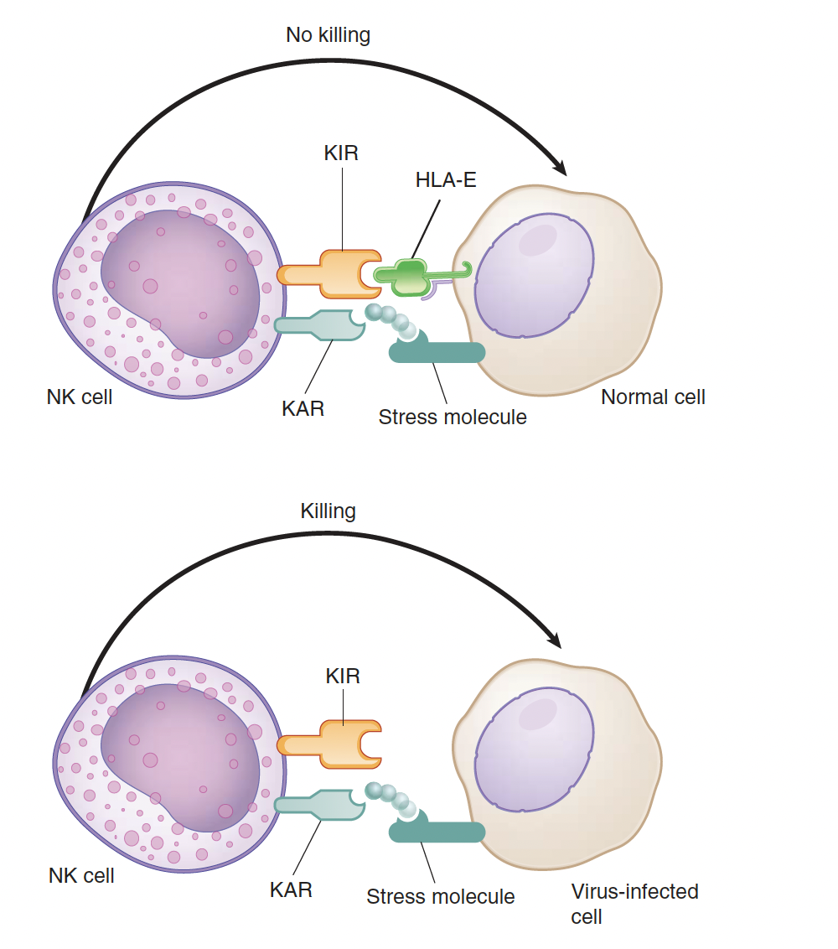
NK cells
NK cells exhibit capacity to kill virally infected cells and tumor cells
They kill be inducing apoptosis
NK activity is increased in the presence of interferons and IL-12
NK cells employ 2 receptors;
Killer activating receptor (KAR)
Killer inhibiting receptor (KIR)

Slide 24
Secondary Lymphoid Tissue: Innate Meets Adaptive

Slide 25
Migration to the Secondary Lymphoid tissue
Following acute inflammatory response, the professional APCs that have phagocytosed and processed invading antigens begin to leave the area via lymphatic vessels
Pro-inflammatory cytokines produce during acute inflammatory response cause a change the phenotype of the phagocyte which eventually alter their migration pattern and enhances their function
Activated dendritic cells begin to express a chemokine receptor CCR7
CCR7 is activated by chemokines that are produce by the endothelium
Notes:
- Dendritic cells are probable the most efficient APC

Slide 26
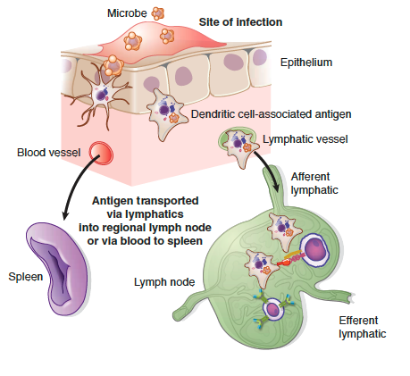
Migration to the Secondary Lymphoid tissue
Chemokines bind to CCR7 on DCs, allowing them to exit the tissue
DCs switch focus from antigen-capture to antigen-presentation
Activated DCs concentrate in draining lymph nodes and become trapped in the paracortex
Naïve T cells expressing CCR7 bind to chemokines on HEVs and migrate to the paracortex
Notes:
HEVs – High endothelial venules
Considering the vast number of pathogens that enter the body, it would be a nearly impossible task for lymphoid cells to travel to all body sites to protect the host.
Thus, antigens are taken to the secondary lymphoid tissues where lymphocytes constantly recirculate in order to come into contact with specific antigen.

Slide 27
Antigen Processing and Presentation
Dendritic cells are the most prolific of the APCs, as they do not have to be activated in order to present antigen to T cells.
They express the co-stimulatory molecules needed to activate the T cells
Macrophages help activate the Th1 response by digesting microbes and presenting them to the T cells to elicit a cell-mediated immunity
B cells present specific protein antigens to T cells to help elicit a humoral immune response or a Th2 response.
Notes:
The first critical step in the elicitation of the adaptive immune response to a primary antigenic challenge is the processing of antigen for presentation to naïve T lymphocytes
Professional antigen-presenting cells (APCs) include dendritic cells, macrophages and B cells, load partially degraded peptides into the groove of the MHC class II molecules.

Slide 28
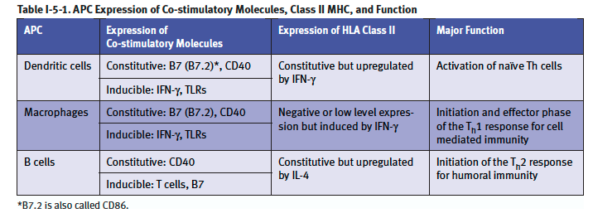

Slide 29
Endogenous Pathway of Antigen-Presentation
This pathway of antigen-processing handles threats to the host which are intracellular (viruses, tumors) or even peptides from pathogens that may escape phagosomes.
These peptides are transported through TAP complex (transporter of antigen processing)
Tapasin bridges the TAP tranporter to the MHC class I molecule
The peptide-MHC class I complexes are then transported to the cell membrane where they may be presented to CD8+ T cells.

Slide 30
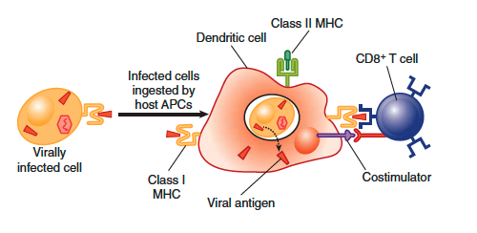
Cross Preseantation

Slide 31
At this time you should know the following:
Differences between the non-specific and specific immune functions
Humoral components of the non-specific immune system and their action
Cellular components of the non-specific immune function and their action
Pathways of intracellular killing of bacteria by phagocytes and their characteristic features
Effect of humoral components such as interferon, TNF, IL-2, complement etc. on cellular components of the non-specific immune system

Slide 32
Questions

